Slide 1
Advancing Green Computing: Practices, strategies, and impact in modern software development for environmental sustainability Shruthi S Rao 1NT20IS158

Slide 2
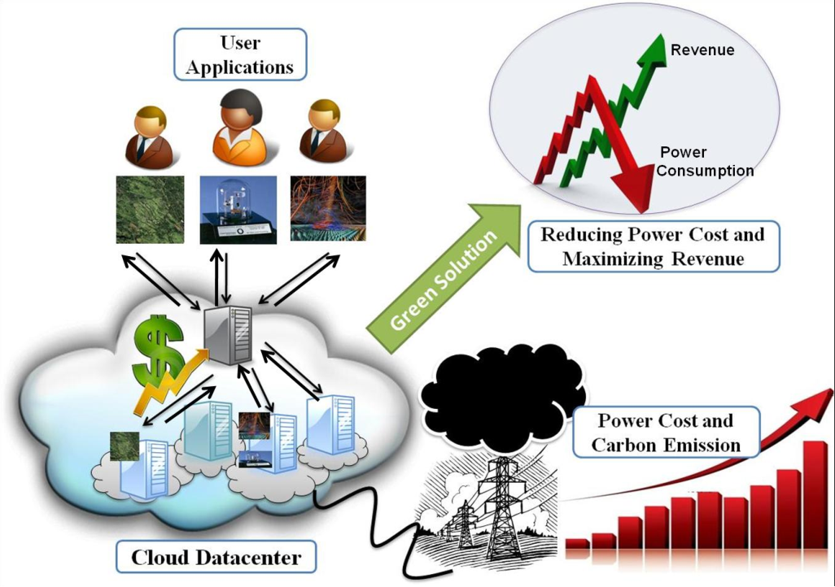
Problem Statement:
Traditional software development practices contribute to environmental degradation due to high energy consumption and electronic waste generation, exacerbating resource depletion and increasing carbon footprint. Limited adoption of green computing hampers sustainability efforts, necessitating innovative strategies to integrate environmental sustainability into modern software development processes.

Slide 3
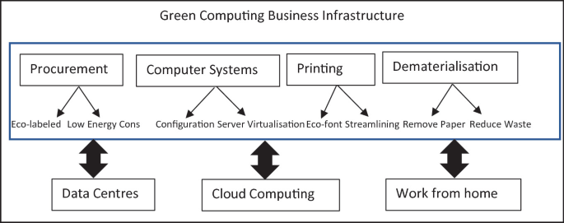
Objective:
Examine Practices and Strategies: Investigate various practices and strategies to incorporate green computing principles into software development processes.
Evaluate Impact: Assess the effects of these practices on environmental sustainability metrics, including energy consumption, carbon emissions, and electronic waste generation.
Through these objectives, the paper aims to:
Inform and Empower: Provide insights to software developers, organizations, and policymakers to make informed decisions and prioritize environmental sustainability in their operations.
Drive Action: Encourage the adoption of green computing practices to mitigate environmental impact and promote sustainable development in the software industry.

Slide 4
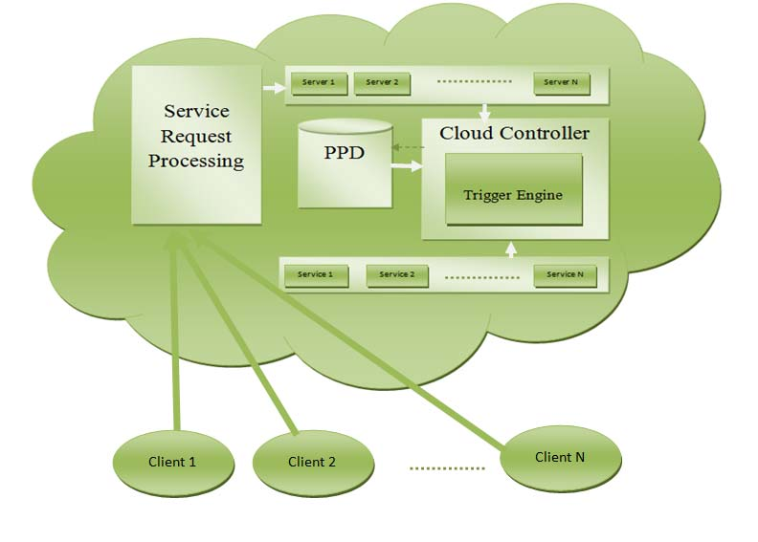
Significance:
Environmental Preservation: Green computing practices contribute to mitigating climate change and reducing the ecological footprint of software development.
Resource Conservation: By optimizing energy usage and reducing electronic waste, green computing conserves natural resources and minimizes environmental strain.
Sustainability Goals: Advancing green computing aligns with global sustainability objectives, fostering a more environmentally responsible software industry.
Cost Savings: Implementing green computing strategies can lead to reduced energy costs and operational expenses, enhancing the economic viability of software development.
Corporate Responsibility: Embracing green computing demonstrates corporate social responsibility, enhancing brand reputation and stakeholder trust.

Slide 5
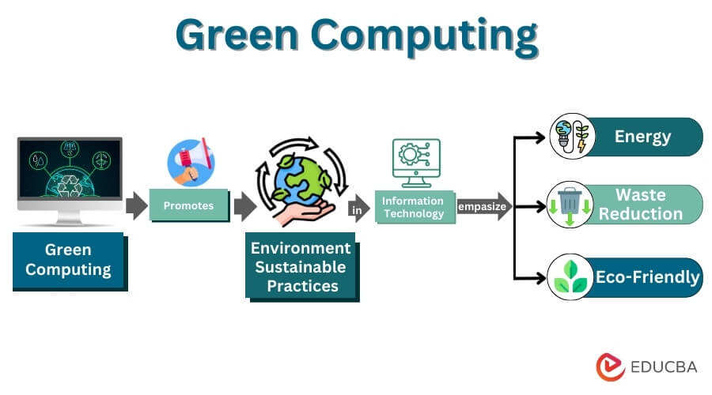
Understanding Green Computing:
Definition: Utilizing computing resources responsibly to minimize energy consumption, carbon emissions, and ecological impact.
Key Components: Energy-efficient hardware, power management techniques, eco-friendly software solutions, responsible disposal of electronic waste.
Significance: Mitigates the environmental impact of the IT industry's energy consumption and carbon emissions.
Evolution: Started with hardware-based solutions in the 1990s, now encompasses software optimization, data centre efficiency, and lifecycle management.
Impact: Promotes energy efficiency, waste reduction, and responsible resource management, contributing to a more sustainable future for the IT industry and society.
Role: Central in shaping the future of technology, aligning with corporate social responsibility objectives, and driving positive global change.

Slide 6
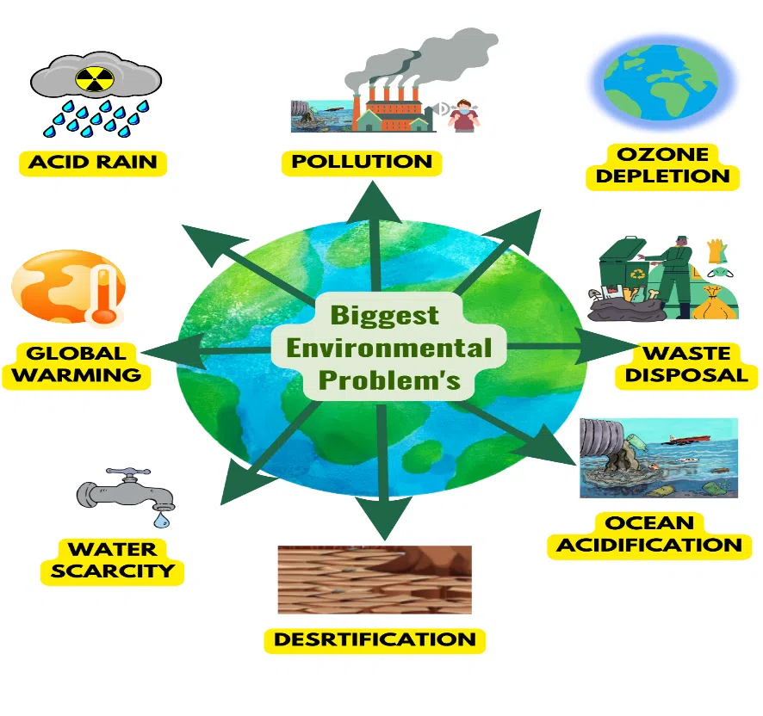
Environmental Challenges in Software Development:
Lifecycle Impact: Software development processes contribute to environmental degradation throughout the software lifecycle, from design to disposal.
Energy Intensity: High energy consumption during tasks like compilation, testing, and deployment, driven by computing infrastructure and data centres.
Carbon Emissions: Significant greenhouse gas emissions from energy consumption, particularly from non-renewable sources like coal and natural gas.
Electronic Waste: Rapid technological innovation leads to the short lifecycle of hardware components, contributing to the accumulation of electronic waste.
Growing Impact: As demand for software solutions increases, so does the environmental impact, placing strain on energy resources and exacerbating climate change.

Slide 7
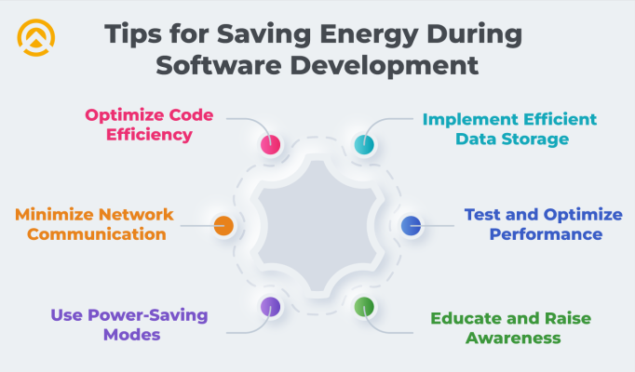
Practices for Green Computing in Software Development:
Code Optimization: Reduce energy consumption by minimizing redundant code, optimizing algorithms, and reducing instructions executed during program execution.
Energy-Efficient Architectures: Select low-power processors, energy-efficient servers, and hardware components to minimize energy consumption.
Sustainable Design Principles: Design software with modularity, scalability, and resource-efficient algorithms to minimize resource consumption and waste.
Green Development Methodologies: Adopt Agile and DevOps practices to streamline development processes, automate tasks, and foster a culture of sustainability.
Renewable Energy Integration: Power data centres and computing infrastructure with renewable energy sources like solar and wind to reduce reliance on fossil fuels and minimize carbon emissions.

Slide 8
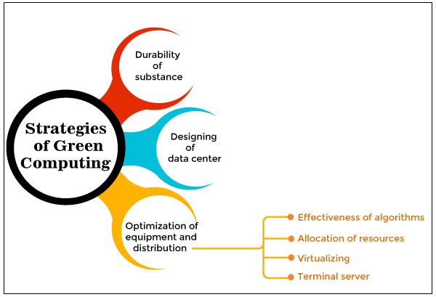
Strategies for Sustainability in Software Development:
Durability of Substances: Emphasize the use of durable materials in hardware manufacturing to extend product lifespan and reduce electronic waste.
Designing Data Centers: Implement sustainable design principles in data centre construction, including efficient cooling systems and renewable energy integration.
Optimization of Equipment and Distribution: Utilize algorithms for resource allocation, virtualization, and terminal servers to optimize energy usage and minimize environmental impact.
Set clear targets for energy and carbon reduction, integrate sustainability into decision-making, and invest in renewable tech.
Collaborate with green vendors, educate on green principles, and enforce regulations for energy efficiency and rewards for sustainability.

Slide 9
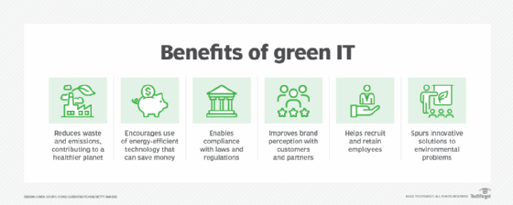
Impact Assessment:
Quantitative Analysis: Assessing energy consumption, carbon emissions, and electronic waste reduction through green computing practices.
Energy Savings: Green computing practices such as server virtualization and software optimization can lead to significant energy savings, up to 80% in some cases.
Environmental Benefits: Implementation of sustainable data centre designs can result in up to 40% reduction in carbon emissions compared to conventional designs.

Slide 10
Applications:
Google: Invested in renewable energy and energy-efficient data centre technologies, achieving significant reductions in energy consumption and carbon emissions.
Salesforce: Achieved carbon neutrality through energy efficiency measures, renewable energy procurement, and carbon offsetting initiatives.
Economic Benefits: Green computing initiatives can lead to substantial cost savings, with potential reductions in operating costs by up to 40% and improved ROI by up to 300%.
Corporate Reputation: Organizations prioritizing green computing are viewed more favourably, leading to increased trust and loyalty from customers and stakeholders.
Employee Productivity: Green computing practices create healthier and more sustainable work environments, resulting in higher levels of employee satisfaction, productivity, and job performance.

Slide 11

Advantages And Disadvantages
Advantages:
Reduced energy consumption
Minimized environmental impact
Cost savings through energy efficiency
Enhanced corporate reputation
Innovation in sustainable technology solutions
Disadvantages:
Initial investment costs for green technologies
Technical complexity in implementation
Resistance to change within organizations
Lack of awareness about the environmental impact

Slide 12

Challenges:
Awareness Gap: Many developers and organizations are unaware of the environmental impact and benefits of green computing practices, hindering adoption.
Cost Considerations: Initial investments in green computing technologies may be perceived as barriers due to upfront costs.
Technical Complexity: Implementing green computing practices requires technical expertise and resources, posing challenges for some organizations.
Resistance to Change: Cultural and organizational barriers can impede the adoption of green computing initiatives within organizations.

Slide 13
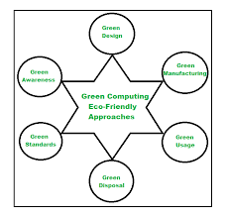
Future Directions:
Advancements in Hardware: Continued advancements in energy-efficient hardware offer opportunities for reducing energy consumption.
Renewable Energy Integration: The growing availability and affordability of renewable energy sources present opportunities to power data centres with clean energy.
AI and ML Optimization: Leveraging AI and ML algorithms can enhance energy efficiency and sustainability in software development.
Collaboration and Education: Increase awareness through education initiatives and foster collaboration between stakeholders to drive innovation and promote sustainability.

Slide 14

Conclusion:
The future of green computing in modern software development relies on collective action, collaboration, and a steadfast commitment to environmental sustainability. Prioritizing green computing practices is not just a choice but a necessity to drive positive change, foster innovation, and pave the way for a more sustainable future for both technology and society as a whole.

Slide 15
Thank You!

